Slide 1

Beverage Sales Report of US Markets
Project By:
Anuthama Raghu Bharathwaj

Slide 2
Motivation/Business Context
The analysis could help businesses to identify the most popular beverages in each region and adjust their marketing strategy accordingly.
This information could be used to optimize the inventory management and ensure that there is enough stock available to meet the demand.
With the help of Tableau, the dataset can be visualized to help businesses make more informed decisions about their marketing, sales, and pricing strategies for different types of beverages in different regions of the US.
Based on the visualization, we can identify the trends or patterns that emerge and generate data-driven recommendations for targeting specific regions with higher market potential to drive business success.

Slide 3





Data Description
https://www.kaggle.com/datasets/dsfelix/us-stores-sales
Format: CSV
The data is specific to the inventory, sales, profit of the following beverages – Coffee, Espresso, Tea, and Herbal Tea by targeting some significant states in the Central, East, West, South markets
Details related to the product (Productid, Description, Type, Category, Sale date)
Accounting Information (Budget Margin, Profit, Total expenses, Marketing)
Geographical Information (Store Area, State, Region, Market Size)
The total number of records accounts to 4248 rows between the year 2010 and 2011.

Slide 4
Data Preparation
Removed area code, time stamp from the data.
Calculated field created:-
Gross profit= Sales - Cost of goods sold.
Margin difference= Budget Margin - Margin.
Net Income= Sales – Expenses.

Slide 5

Research Questions
How diversely does the market size and location affect its accounting variables and what changes can be made to maximize gains?
Which product can be introduced to new states based on margin difference in across every month?
How does the total expenses vary across different US states for each product type and the factors that contribute to these differences?
What impact does a product's marketing budget have on its net income, and how do these effects vary depending on the Market and the type of product?
How does the inventory value evolve over time per product type?

Slide 6
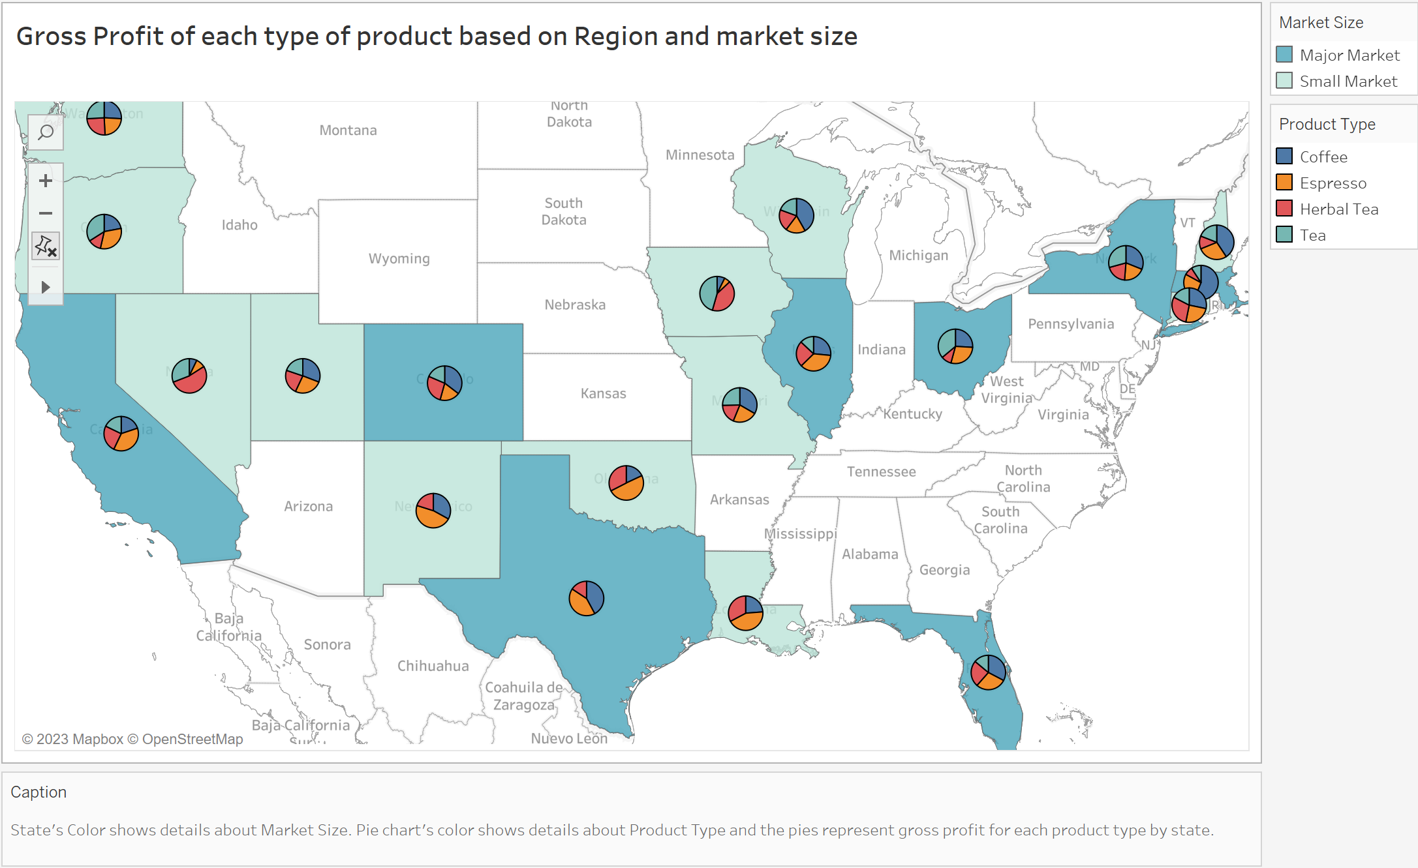

Slide 7
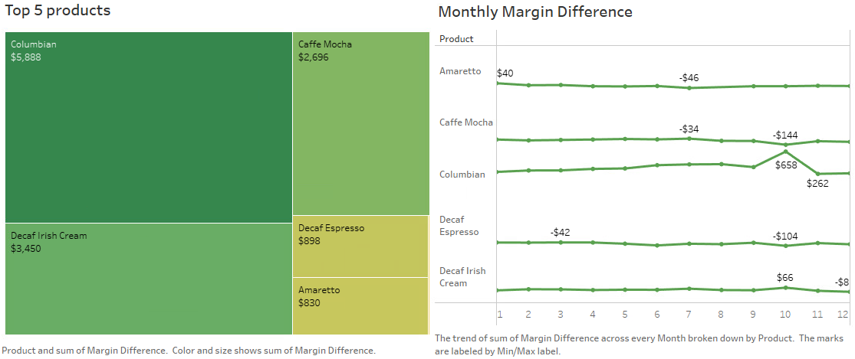

Slide 8
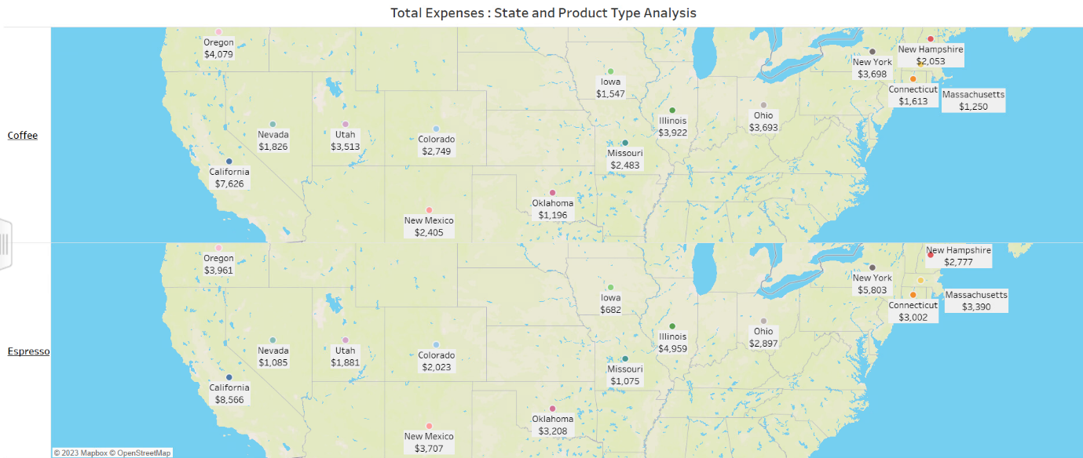
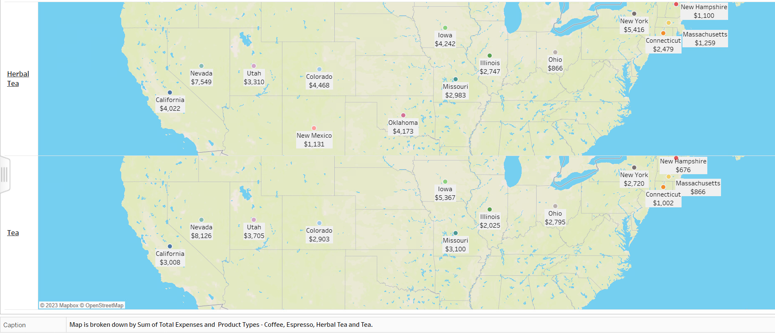

Slide 9
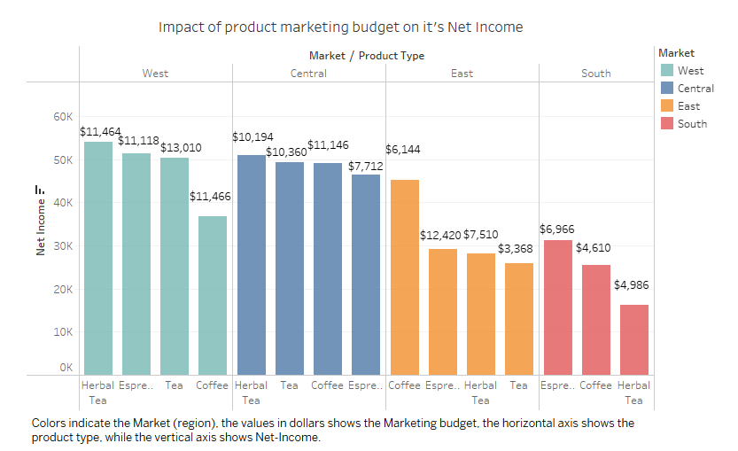

Slide 10
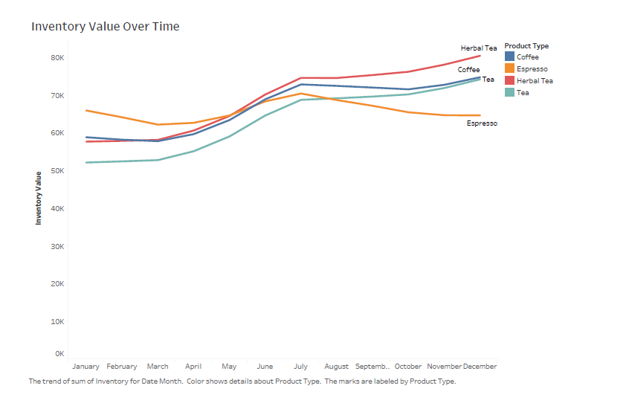

Slide 11
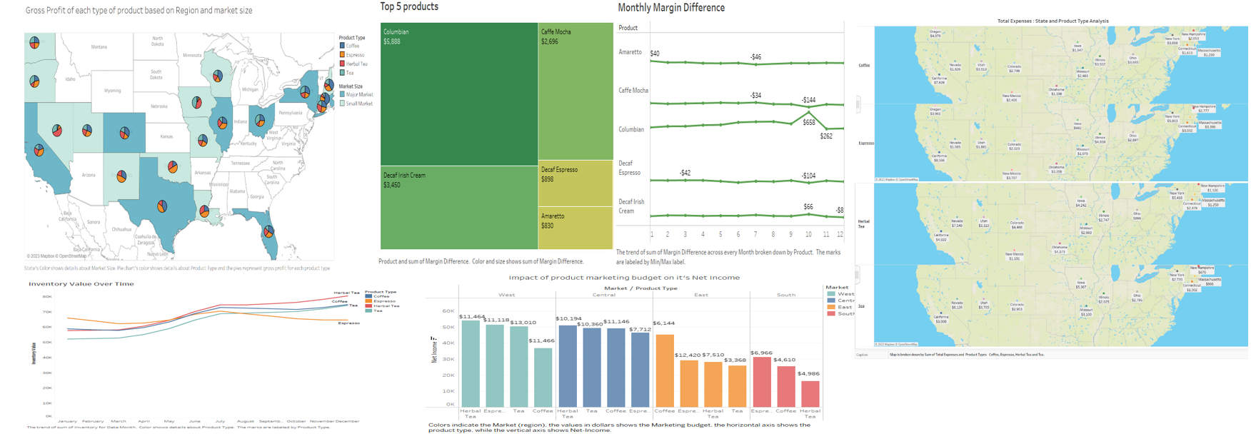
Visualization Dashboard

Slide 12
Lessons Learned
The profit and sales for each Product Type broken down by Market shows us that businesses can develop effective pricing strategies for each type of beverage. This can involve adjusting prices based on regional differences or identifying price points that maximize profits while still appealing to customers.
Visualization can take form in a many ways depending on the type of data, the questions asked, and the audience. We can make complex data more accessible and easier to understand.
It’s easy to make the mistake of including too much information and complexity in the visualization. However, an important aspect of visualization is to be understood by the audience, so it’s important to keep it simple and strive for clarity in the design

